Slide 1
生成式AI技術與數位行銷人才養成班
人工智慧概論
謝欽旭
國立高雄科技大學電子工程系
2025

Slide 2
LIVING WITH ARTIFICIAL INTELLIGENCE
Like the combustion engine and the internet, Al is a general-purpose technology that is changing how we live our lives.
There is no doubt that Al is here to stay. The only question is how do we adapt to it?
Society is already grappling with Al-driven technological unemployment, algorithmic biases that worsen inequality, and an entirely new kind of conflict: cyber warfare. Some researchers even claim that Al is a threat to our species.
However, Als also make life incalculably better for us, particularly in the fields of medicine, finance, and agriculture.
How to ensure that Als are only ever used for good remains an urgent and unresolved subject of debate.

Slide 3
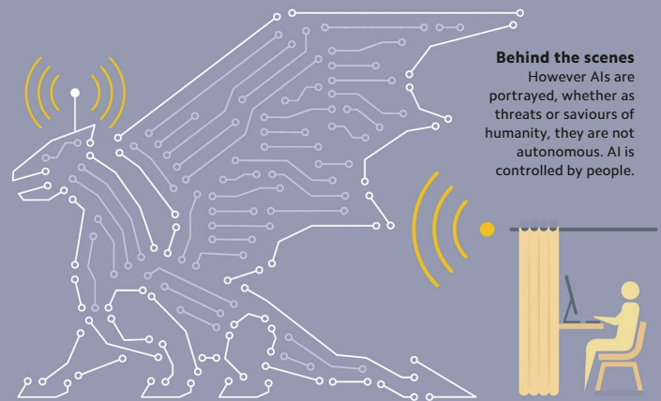
MYTH OR REALITY? - THE TRUTH ABOUT Al
Some Al myths evoke fear, predicting killer robots, rogue algorithms, and other existential risks.
In reality, Al applications have, at best, limited and specific abilities, and cannot think for themselves. They are only capable of what they are programmed to do.

Slide 4
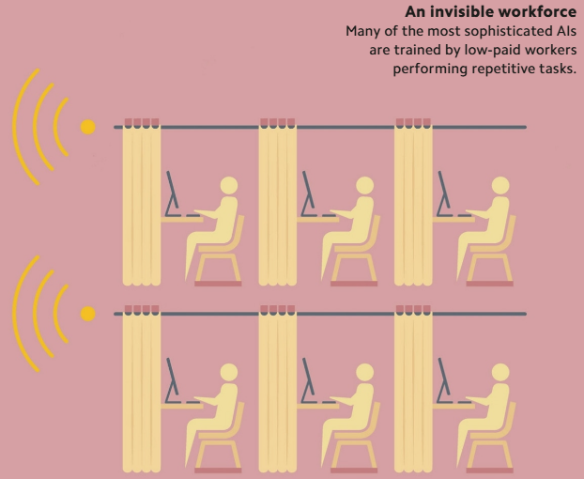
POWERED BY EXPLOITATION? - INVISIBLE LABOUR
Hidden behind many of today's Als is a vast amount of human labour.
Millions of workers are employed to train Als (e.g. to label images or flag abusive content). These workers are often based in countries with poor wages and rights, in contrast to the well-paid engineers leading the projects.
Additionally, generative Al relies on data "scraped“ from the internet - including copyright-protected material such as books and art - without the consent or compensation of the human creators, who could eventually find themselves out-competed by the very Als that are trained on their work.

Slide 5
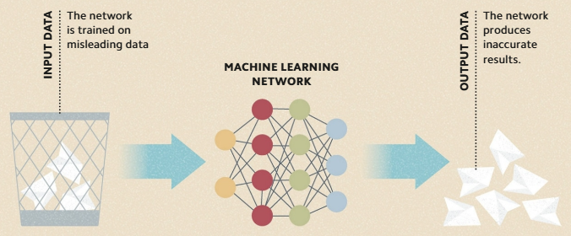
GARBAGE IN, GARBAGE OUT - DATA QUALITY
Machine-learning networks are only as good as the data on which they are trained.
The most common cause of inaccurate results from an Al system is poor-quality training data, which includes input data that is incomplete, poorly labeled, full of errors, or biased.
In the field of computer science, the idea that bad inputs produce bad outputs is informally summarized as "garbage in garbage out," or "GICO.”

Slide 6
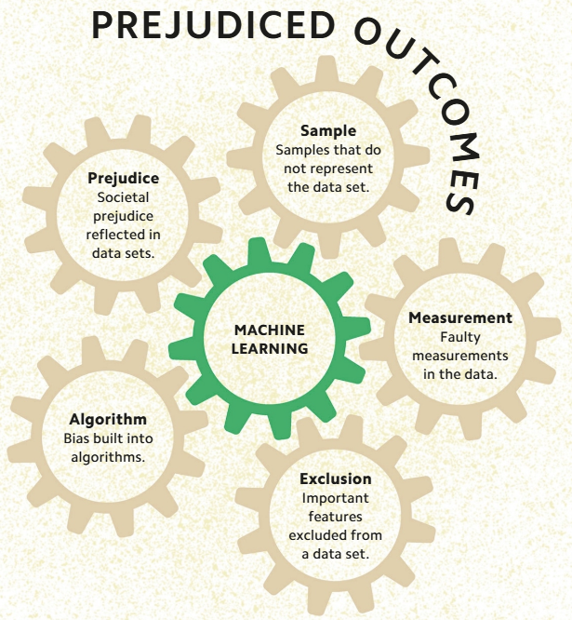
PREJUDICED OUTCOMES - HIDDEN BIAS
The term "Al bias" is used to describe Al systems that produce unfair results for particular groups of people.
Al biases often reflect prejudices in society about gender, ethnicity, culture, age, and many others.
Bias usually stems from the programmers themselves, via their algorithms and their interpretations of results, and from the data sets used to train an Al.

Slide 7
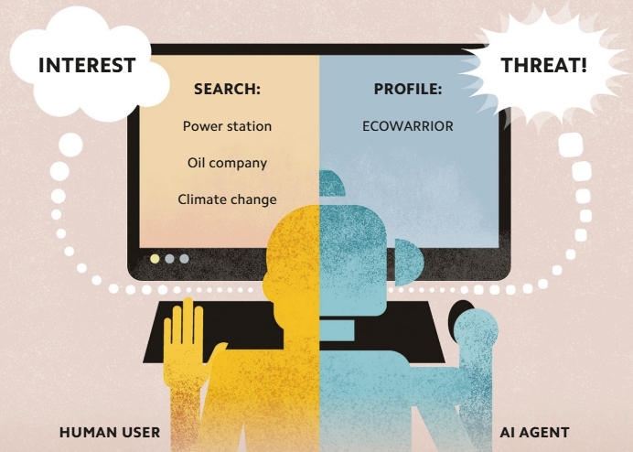
MAKING ASSUMPTIONS - Al PROFILING
Using personal data to try to predict an individual's future desires, opinions, and activities is known as "profiling.“
However, profiling can be problematic, since it can lead to false and even damaging predictions due to biases built into data sets and algorithms.
In order to root out such biases, it is essential that Al decision-making processes be transparent.

Slide 8
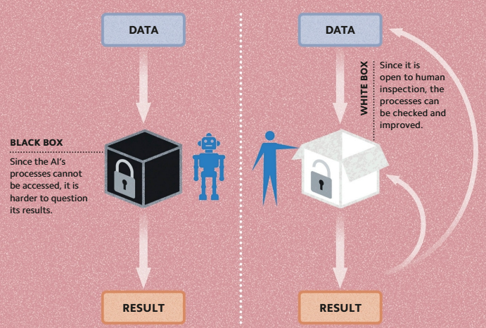
TRANSPARENT PROCESSING - WHITE BOX Al
Machine-learning models process data and make predictions using highly complex artificial neural networks . The inner workings of these models are often said to be a "black box" because they are too complicated and abstract for humans to "observe."
An alternative approach, known as "interpretable machine learning," or "white box Al," shines a light into the black box.
White box Als are designed to give not just the result, but a breakdown of the processes they followed to reach it.

Slide 9
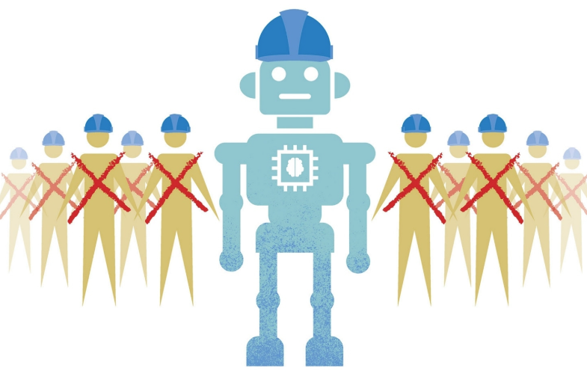
AN Al WORKFORCE - TECHNOLOGICAL UNEMPLOYMENT
The replacement of human beings by machines in the workforce is known as "technological unemployment".
Up until now, this phenomenon has not led to mass unemployment, because machines greatly increase productivity, which in turn stimulates the economy and creates new job opportunities.
However if Als begin to pass the employment test, and achieve the intelligence level of AGIs, then, one day, there may be few jobs left for human beings to do.

Slide 10
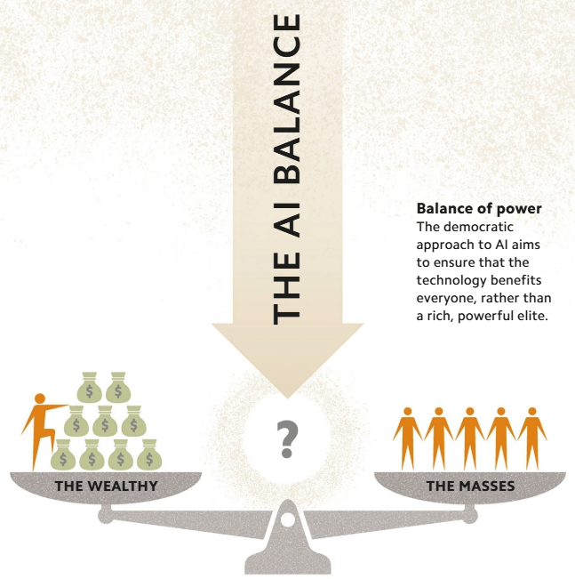
THE AI BALANCE - Al AND EQUALITY
Al has the potential to increase productivity and generate income and opportunity.
Shared by all, these benefits could create a more equal world, but if concentrated in the hands of the wealthy and powerful, the gulf between rich and poor will widen.
Bias in design, data, and how and where Als are used can exacerbate social divides, increase inequality, and lead to hazardous and discriminatory applications.

Slide 11
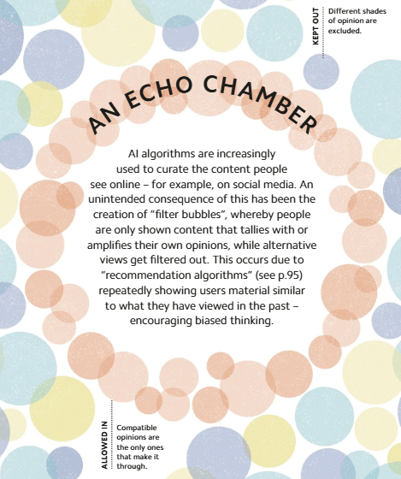
AN ECHO CHAMBER - FILTER BUBBLES
Al algorithms are increasingly used to curate the content people see online—for example, on social media.
An unintended consequence of this has been the creation of "filter bubbles," whereby people are shown only content that tallies with or amplifies their own opinions, while alternative views get filtered out.
This occurs due to "recommendation algorithms."

Slide 12
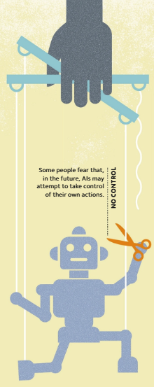
THE LIMIT OF CONTROL - AI AUTONOMY
If an Al is to maximize its usefulness, it will need to be autonomous to an extent—that is, capable of independent decision-making.
However, the more autonomous and powerful an Al becomes, the harder it will be to control.
A fully autonomous Al might be able to ignore or contradict the instructions of its controllers, and even take active steps to maintain its independence.
Once an Al is beyond human influence and restraint, its behavior would be unpredictable.

Slide 13
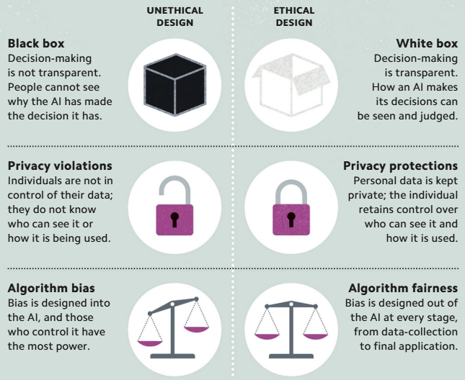
RIGHT VS. WRONG - ETHICAL DESIGN
As Als become ever more intelligent, the question of how to ensure that they behave ethically becomes increasingly important.
The only way to ensure that Als think ethically is to program them with ethical principles.

Slide 14
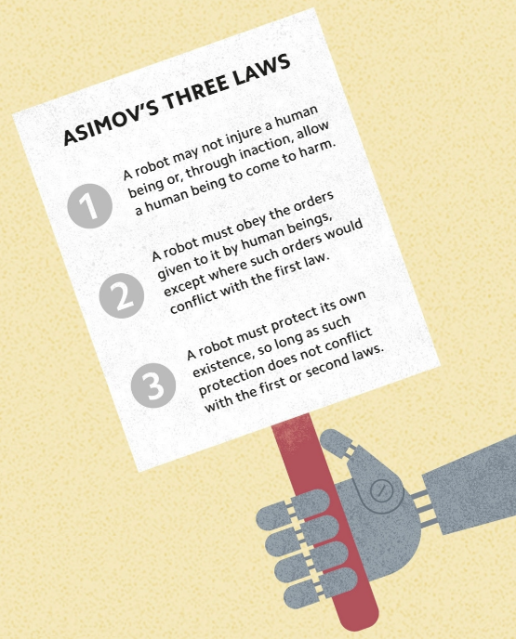
BUILT-IN ETHICS - ASIMOV'S THREE LAWS
One way of ensuring that Als behave ethically is to program them with specific ethical rules or laws—a process known as "terminal value loading.“
The classic illustration of this can be found in the science fiction stories of Isaac Asimov (1920-92), who formulated what he called the "three laws of robotics".
An Al may be instructed not to harm a human being, but doing so may be the only way of saving a person's life.

Slide 15
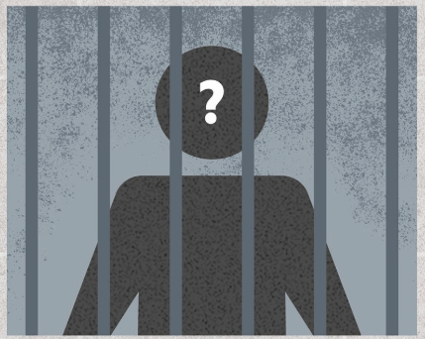
WHO IS TO BLAME? - Al AND LIABILITY
Some researchers argue that, one day, Als will not only be as intelligent as human beings, they will also have humanlike personalities, and so should be granted human rights.
If an Al is given such rights, lawmakers would have to decide where to draw the line between holding the Al or its makers responsible for its actions.

Slide 16
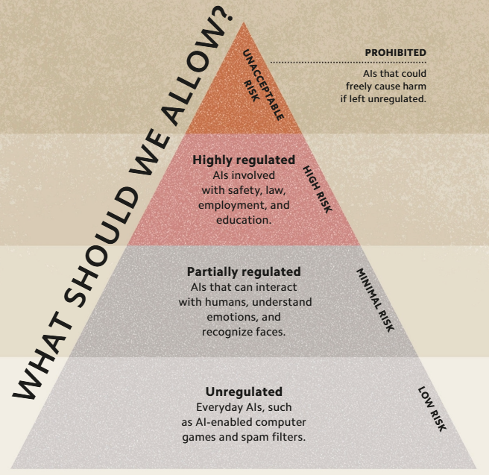
WHAT SHOULD WE ALLOW? - Al AND REGULATION
Concerns about the dangers that Als may pose in the future have fueled calls for Al research to be regulated.
However, many scientists argue that regulating research will stifle innovation, and give unregulated countries a dangerous advantage.
A compromise, proposed by European regulators, is to scale regulation according to risk

Slide 17
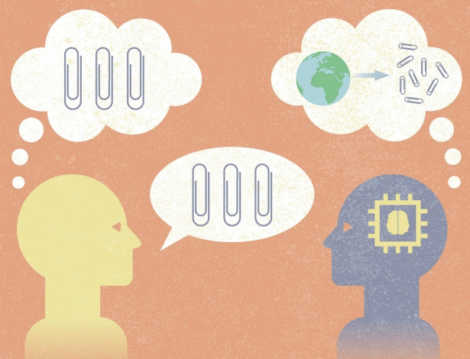
EXISTENTIAL RISKS - AN AI DYSTOPIA
One possible threat posed by Al is known as the "alignment problem," whereby the goals and values of an Al do not align with those of humanity.
Named after a scene in the Disney cartoon Fantasia, in which a sorcerer's apprentice makes a broom multiply uncontrollably, "Sorcerer's Apprentice Syndrome" neatly illustrates the problem in the form of a thought experiment.
An Al is given the task of optimizing the production of paperclips, but believes that its job is only done when it has converted the entire planet into paperclips.
It does so because it does not realize that it must prioritize human life over paperclip production.

Slide 18
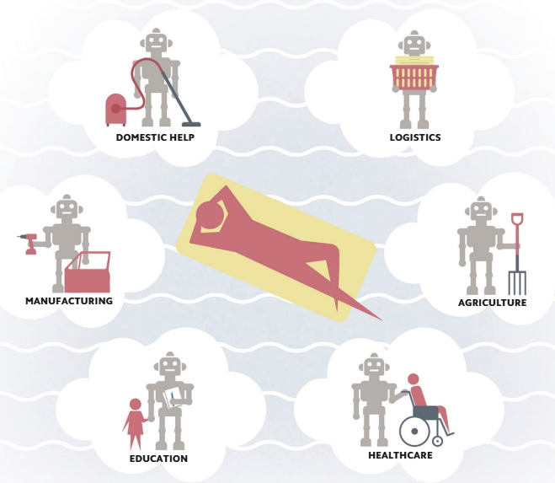
UNLIMITED REWARDS - AN Al UTOPIA
Many Al researchers believe that Al will usher in a golden age for humanity—a time when machines will generate limitless abundance and prosperity.
They argue that, with more powerful Als doing all the work that humans used to do, people will finally be free to devote their time to leisure activities and to pursuing their personal dreams.
At such a time, they claim, there will be no scarcity of resources, and so no crime, war, or injustice—and Als will be able to help us to solve the world's remaining problems, from disease to climate change.

